Slide 1
A simple “particles in a box” model of adsorption
Kyungjin Lee
Advisor: Professor McCarthy

Slide 2
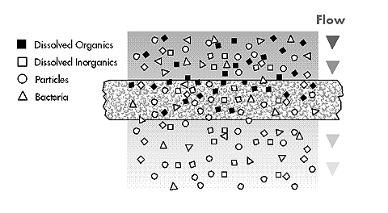
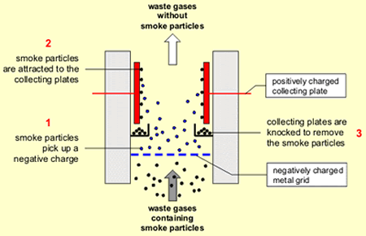
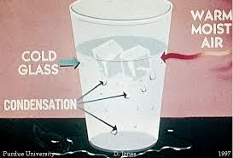
We can remove particles from water or the air by having them stick to surfaces

Slide 3
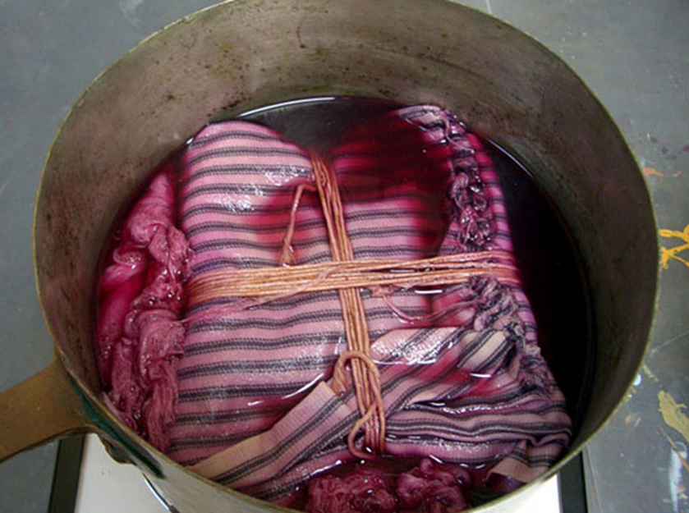
Or we can focus on the surface. Like when we dye fabrics.

Slide 4
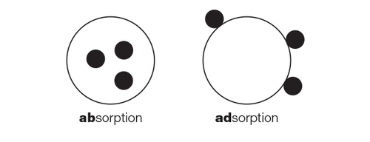
One type of sticking to the surface is: adsorption
Adsorption: the adhesion in an extremely thin layer of molecules (as of gases, solutes, or liquids) to the surfaces of solid bodies or liquids with which they are in contact.
Absorption: when the particles go inside.

Slide 5
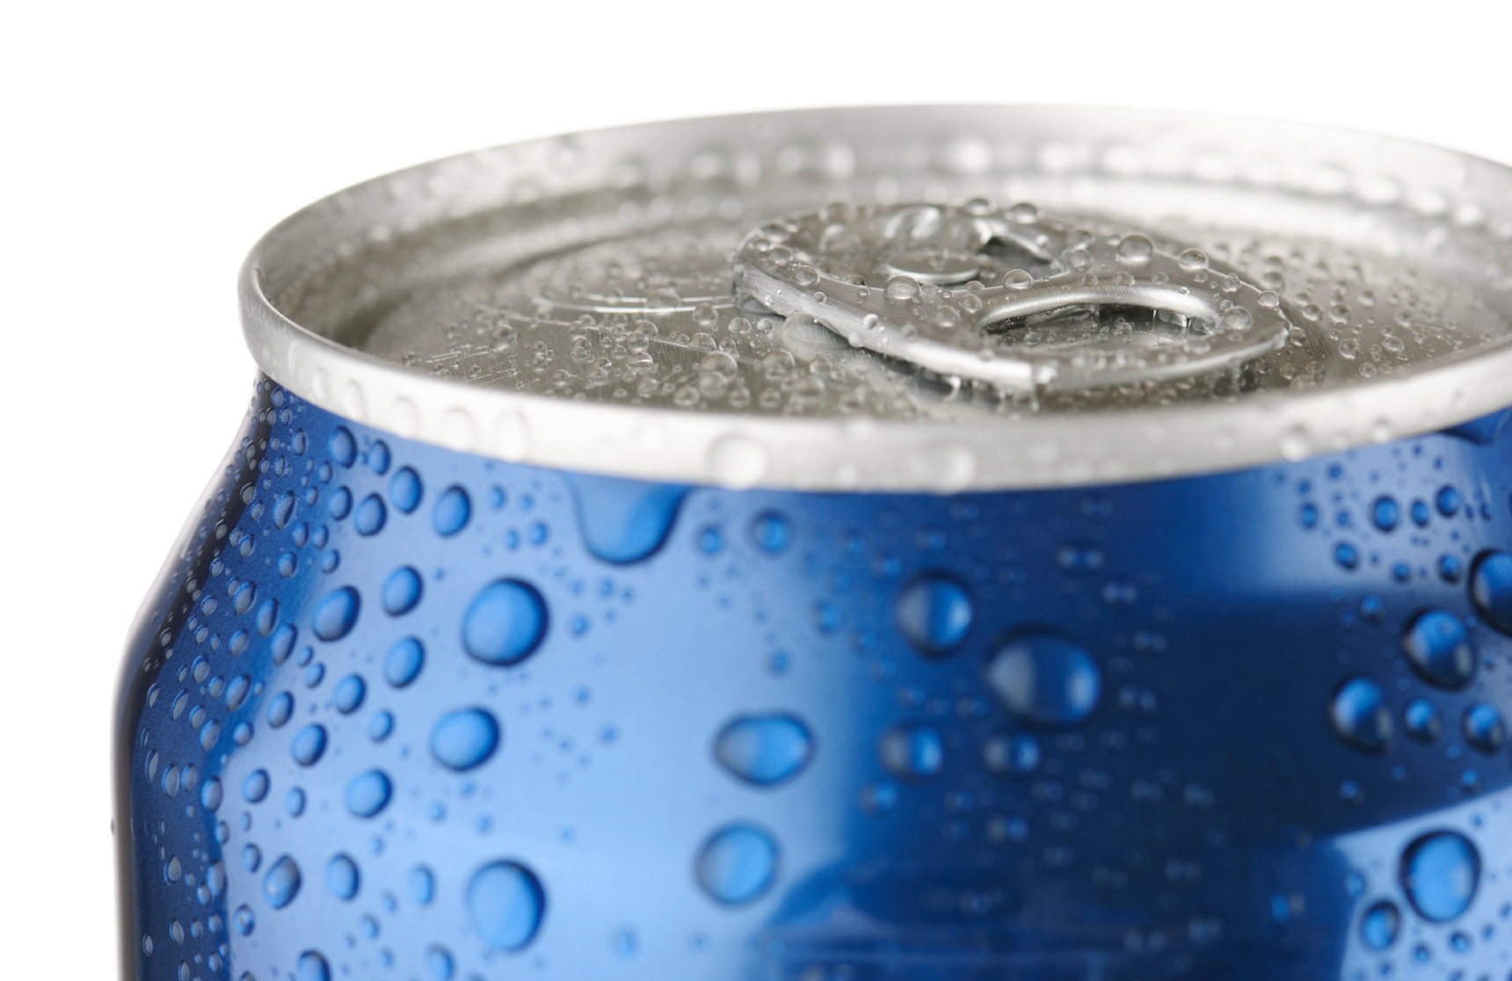
Another type of sticking to the surface is: condensation
Condensation is when a gas condenses into a liquid, often by touching a colder surface.

Slide 6
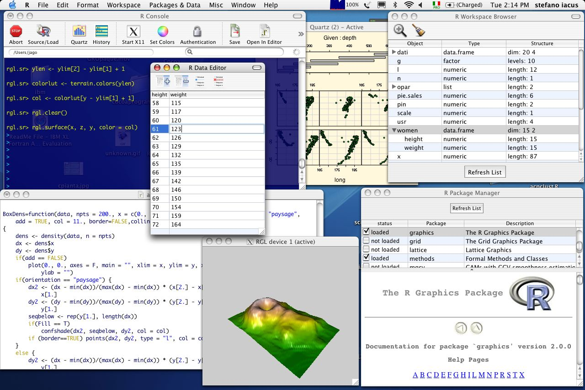

We want to simulate these processes on a computer.
We use the language R.

Slide 7
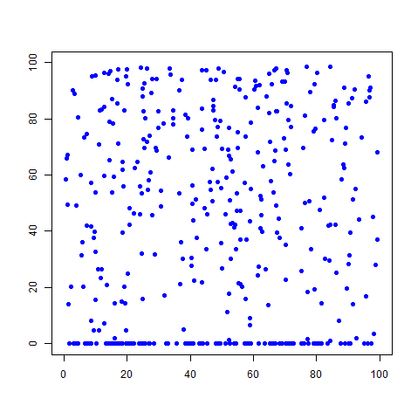
Particles in Box model
Particles will stick to the floor of the box.
They keep sticking till there are no more particles floating or we stop simulation.
For lack of a better term, we call his our condensation model.

Slide 8
Particles in Box model
Dimensions of box is:
100 units x 100 units
Speed of particles about 2 units per time step
At each time step there is a 20% chance the direction a particle moves will change.

Slide 9
(new position) = (old position) + (velocity) (change in time)

Slide 10
Why use Simulations?
Simulations are less time consuming and expensive than lab experiments.
Simulations can help us design things.
Making a simulation forces us to think about what is happening.

Slide 11
Why use Simulations? But keep in mind…
Simulations are less time consuming and expensive than lab experiments.
Simulations can help us design things.
Making a simulation forces us to think about what is happening.
But simulations aren’t real. We need to check simulation with lab experiments.
Even a simple simulation can use a lot of math and be complicated to understand.

Slide 12
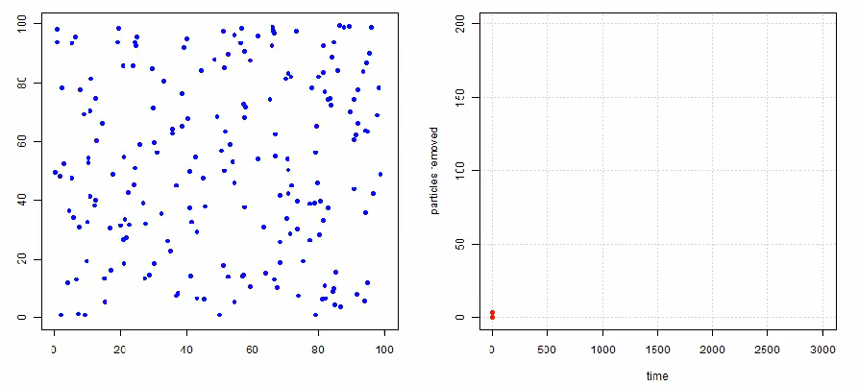
Here is are pictures of our simulation of condensation.
Beginning of simulation

Slide 13
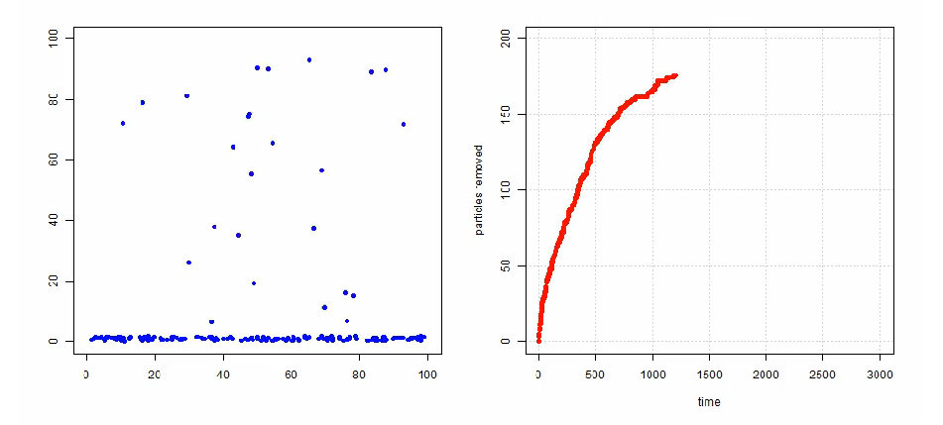
Middle of simulation

Slide 14
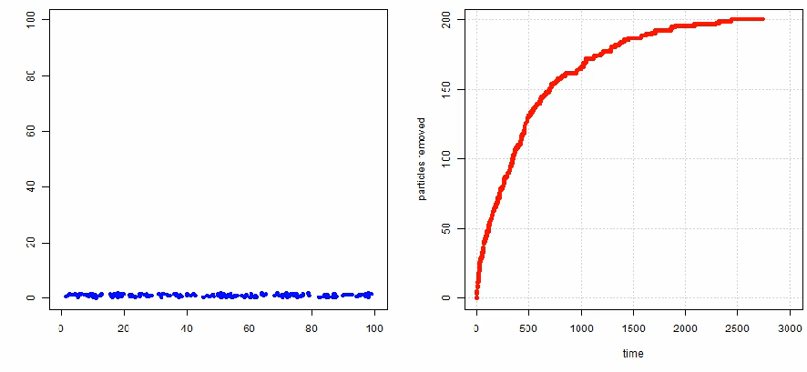
At the end

Slide 15
We can model the simulation using a differential equation
dy/dt = k(n-y) = rate at which particles stick to bottom wall. Is proportional to how many particles are floating free.
The n = how many particles in box
The k = constant > 0
The solution is y = n(1 –exp(-kt))

Slide 16
Difficulties in finding k directly from model.
The particles move about randomly. How fast they move, how big the box is, the shape of box, how the particles change direction, all effect k. Very complicated!
So, it is too difficult (for us) to figure out k from the model.
We can figure out k by doing non-linear regression on the data from the simulation.
A lot of our summer research was understanding what effects k.

Slide 17
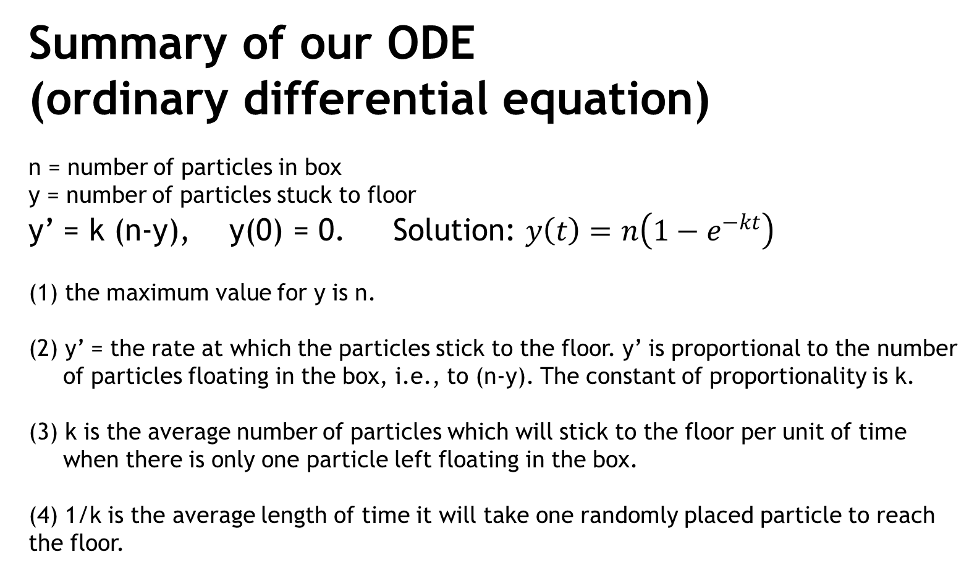
We can explain why finding k is difficult by looking at the differential equation

Slide 18
As a result the k is very interesting and difficult to completely understand.
k = the average number of particles that will stick to the floor per unit of time when there is only one particle in the box.
1/k = average length of time it takes the average particle to stick
to the bottom wall.

Slide 19
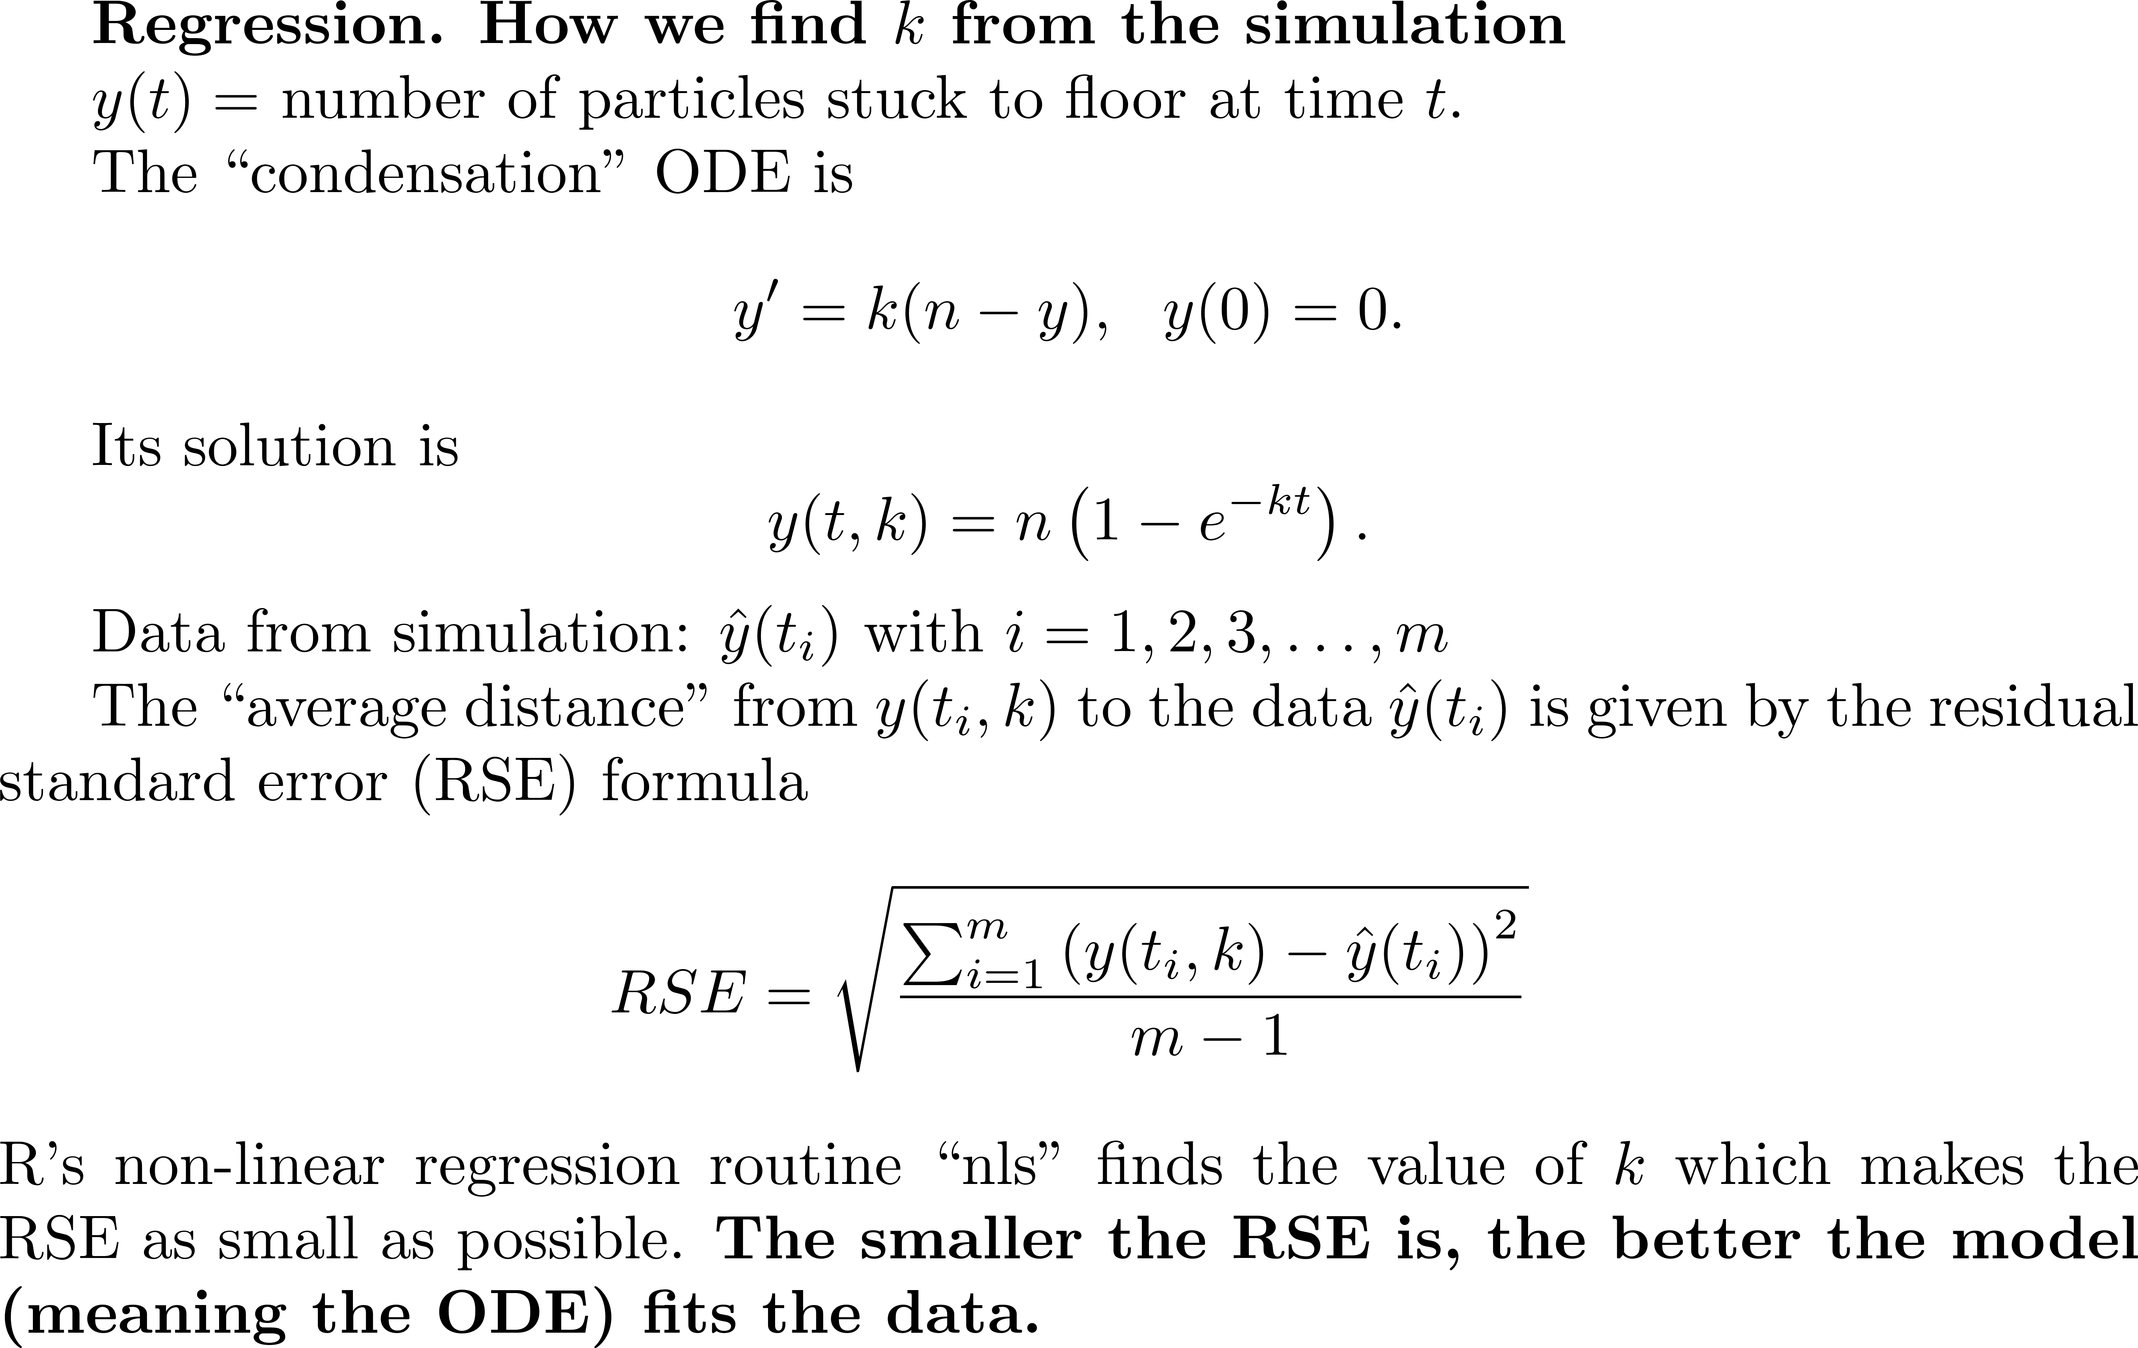

Slide 20
End here for now!
Thank you for listening

